Slide 1






Acute cancer care and end of life – MOST people who die of cancer have an emergency admission in their last year of life
Of people who died of cancer in NI in 2015
  people ( n=3,212) had at least one emergency admission recorded in their last year of life, with 16.8% of people having three or more admissions
  spent more than one month in hospital in last year of life
  of patients with an emergency admission had palliative care recorded as part of their treatment
  died before discharge from hospital
Much (if not most) of this acute cancer care will be provided by non cancer specialists

Slide 2
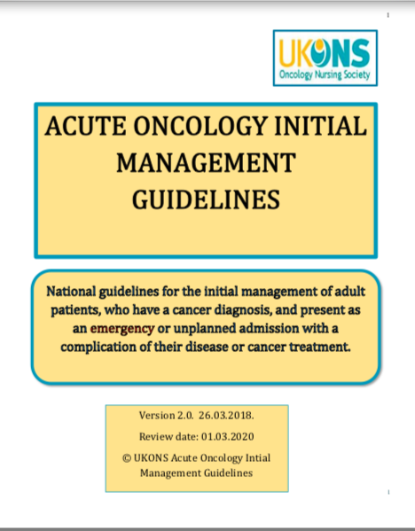
Acute Cancer Care- it’s a messy business
Type 1 - diagnosis of cancer as an emergency
Eg Lung, brain tumours, GI. More likely to have advanced disease and less likely to have anticancer treatment
Type 2 - complications of anti-cancer treatment
Neutropenic sepsis, complications of novel treatments, chemo issues.
Type 3 - progression of disease or cancer as a bystander
Nearly 50% of acute cancer admissions, increasing with the age/frailty & co-morbidities of cancer populations

Slide 3
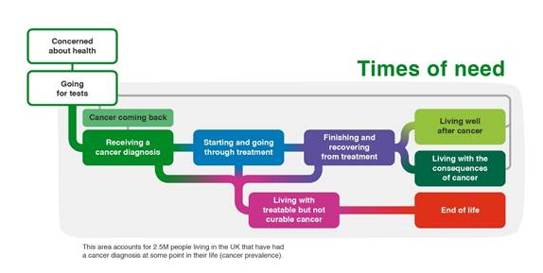
Acute cancer admissions are often a time of transition into incurable disease or end of life care
  If we don’t ‘catch’ people at their first admission with palliative needs they are 50% less likely to die at home Midhurst Specialist Palliative Care at Home 2011
  All acutely unwell cancer patients are at higher risk of death but professionals are not talking about it
    Only 29% of acute oncology inpatients who died from cancer within 12 months had an ICD-10 code of palliative care coded (emergency admissions in last year of life NI macmilan/NICR 2019)
    Just 27% of 265 acutely unwell cancer patients admitted to hospital had a recorded discussion about treatment escalation/CPR (macmillan AO medical student survey 2018)
Notes:
Only 71 percent of those admitted to hospital with cancer had palliative care coded

Slide 4
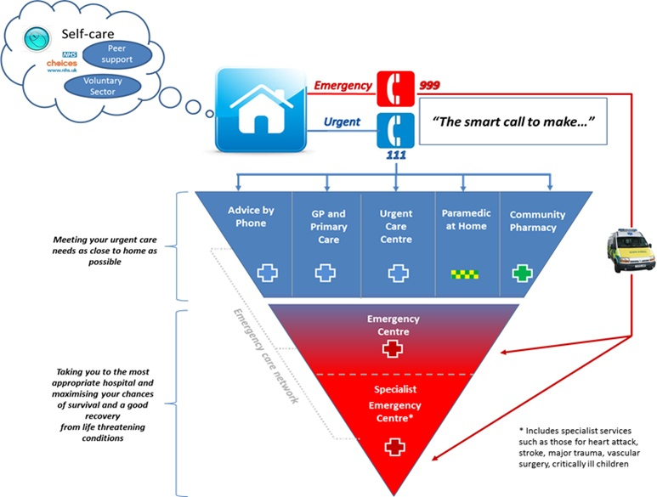
Cancer patients account for large volume of urgent care
Cancer Helpline
~2000 calls/ month
>10% of paramedic activity (SWAS Mac Project)
60% conveyance
Rate to hospital
6% of referrals to ED/direct admission from GP OOH’s
5% of ED attendances and 15% of ED admissions
80% admission rate
~2000 Acute Oncology inpatient referrals/year across 3 hospital in Merseyside
20% mortality rate at 30 days;
70% mortality rate at 12 months!
Notes:
Approx 8 cancer patients/day presenting to A&E with an 80% admission rate
17% of presentations to A&E are patients triaged via CCC cancer helpline
5% of GP OOH’s referrals to A&E/direct admission are cancer (likely an underestimate as coding ineffective for cancer)
AO teams see approx. 50% of cancer patients attending A&E; other half are referred to SPC only

Slide 5
Acute Cancer Care is a team effort
Generalist Assessment
Primary care, community, ED, ICM Acute, Frailty
Speciality support
Geriatrics, cardiology, surgery, anaesthesia palliative care
Cancer specific
Acute Oncology & Specialist cancer teams

