Slide 1
Reducing Inequitable Delays for Procedures for Patients with Learning Disabilities
Adrienne Lee – NIHR Academic Clinical Fellow
John Harrison - Programme Director Clinical Service Strategy and Acute Sustainability Programme,
Gary Minto - Associate Medical Director for R&D,
Saoirse Read - Learning Disability/ and Autism Liaison Service Manager,
Hannah Perkins , Information Business Partner, all UHP
Isabel Smith, Community Liaison, Livewell SW
Sarah Lennard, Manager - Adult LD services – Cornwall Foundation Trust
Prof Rohit Shankar, Director of Cornwall Intellectual Disability Equitable Research CIDER

Slide 2
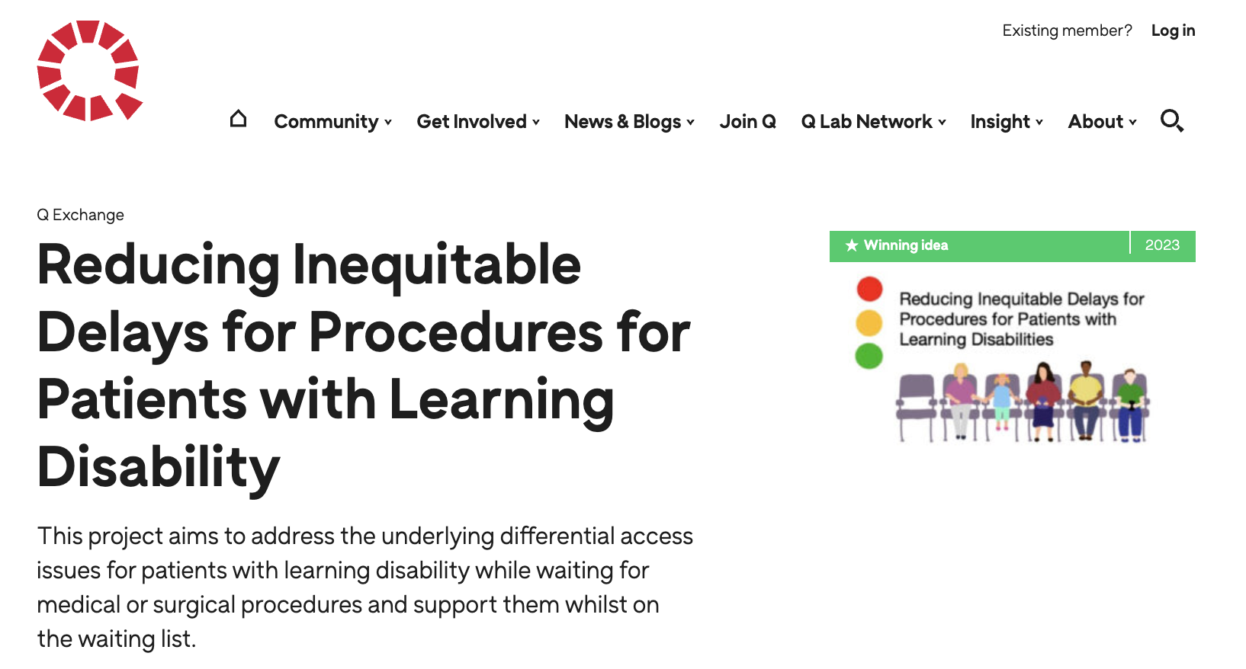
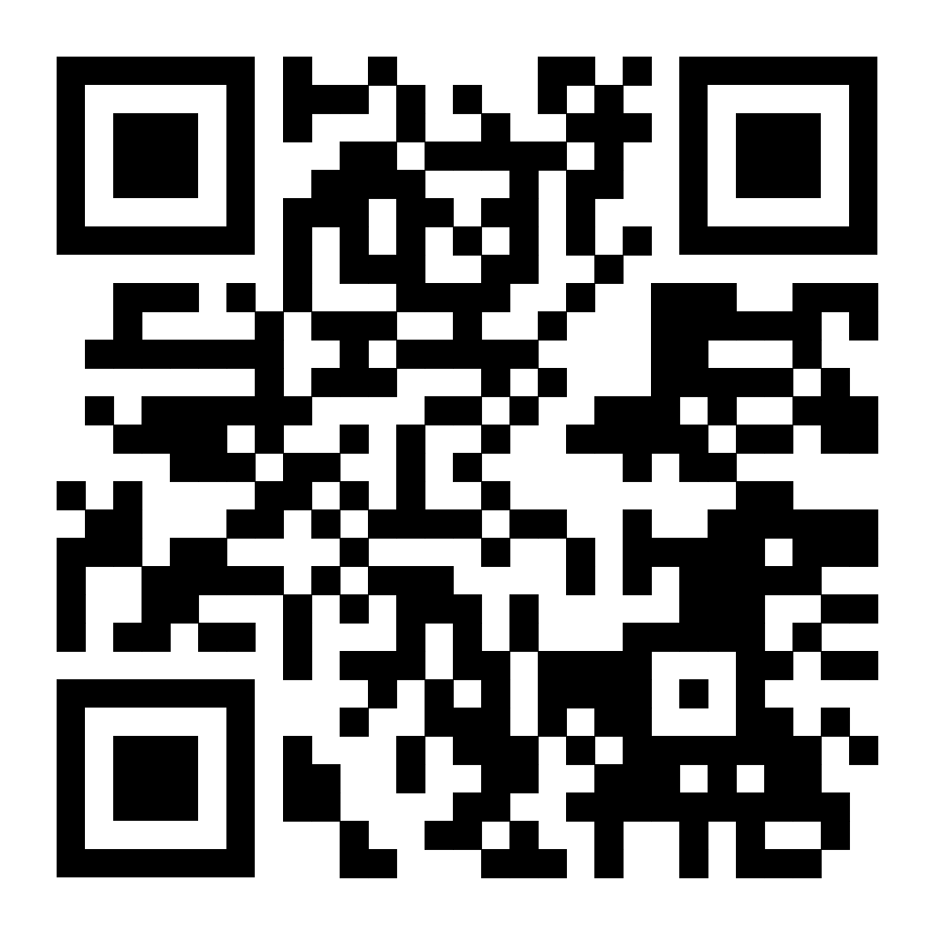
Q Exchange
Exchange Grant

Slide 3
What is Q?
Jointly funded by the Health Foundation and NHS England
Collaborative organization that works to improve the safety and quality of health and care
Aims:
Activate the knowledge of improvement experts across the UK
Create links between those leading work and those who can help champion, support, adopt these ideas
Boost ideas that have the best potential to generate value for the health and care system

Slide 4
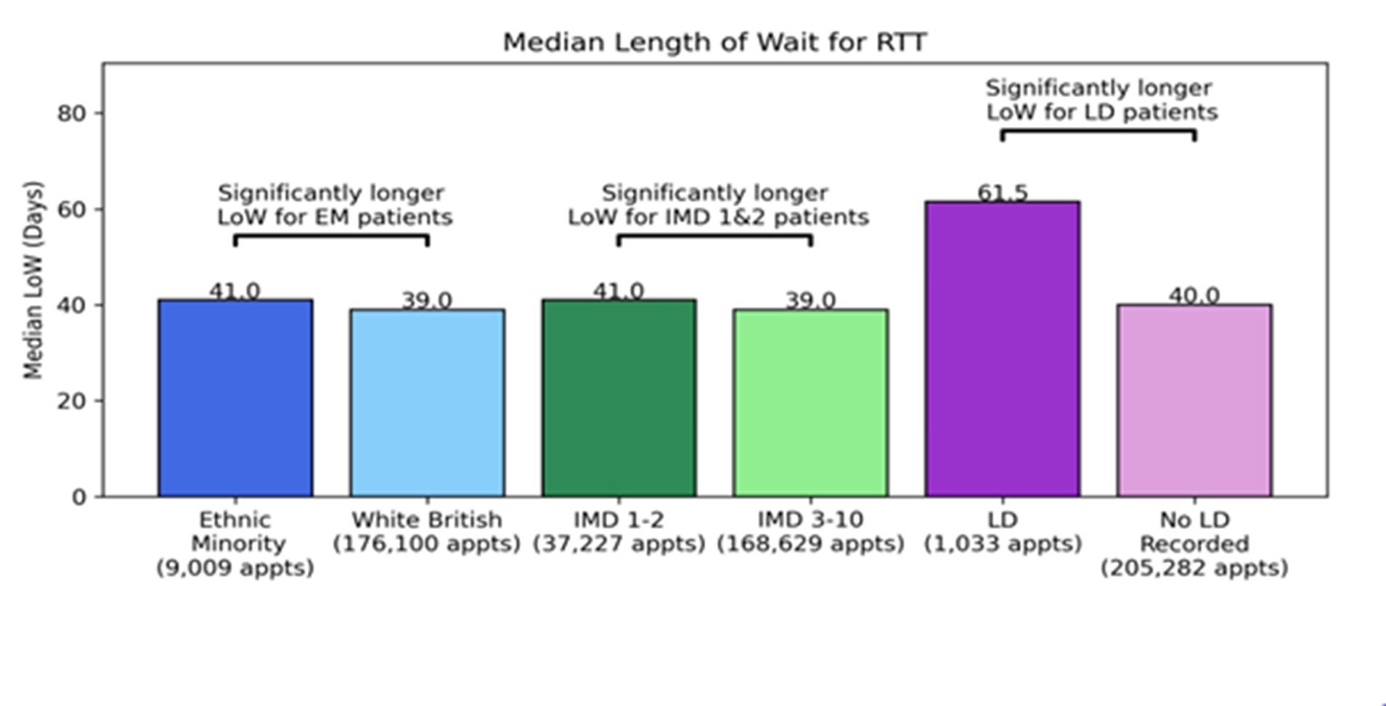
~ 40 000 patients on our waiting list for procedures
Inequities ?
Notes:
Working with a commercial ( but altruistic ) health care data analysis company , Optum – we salami sliced our waiting list data, looking for inequality of access by ethnic minority or socioeconomic status – and there were modest differences , but by far the biggest inequity was for LD

Slide 5
~ 40 000 patients on our waiting list for procedures 750 patients with Learning Disability (LD) or Autism Spectrum Disorder (ASD) among them ( ~2%) Differential access to care Have 5 X increased frequency in attendance in emergency or primary care while they wait
Current Situation
Notes:
& 2 ½ X the spend everyone else

Slide 6
Notes:
Stat signif – Ophth and Dermatology

Slide 7
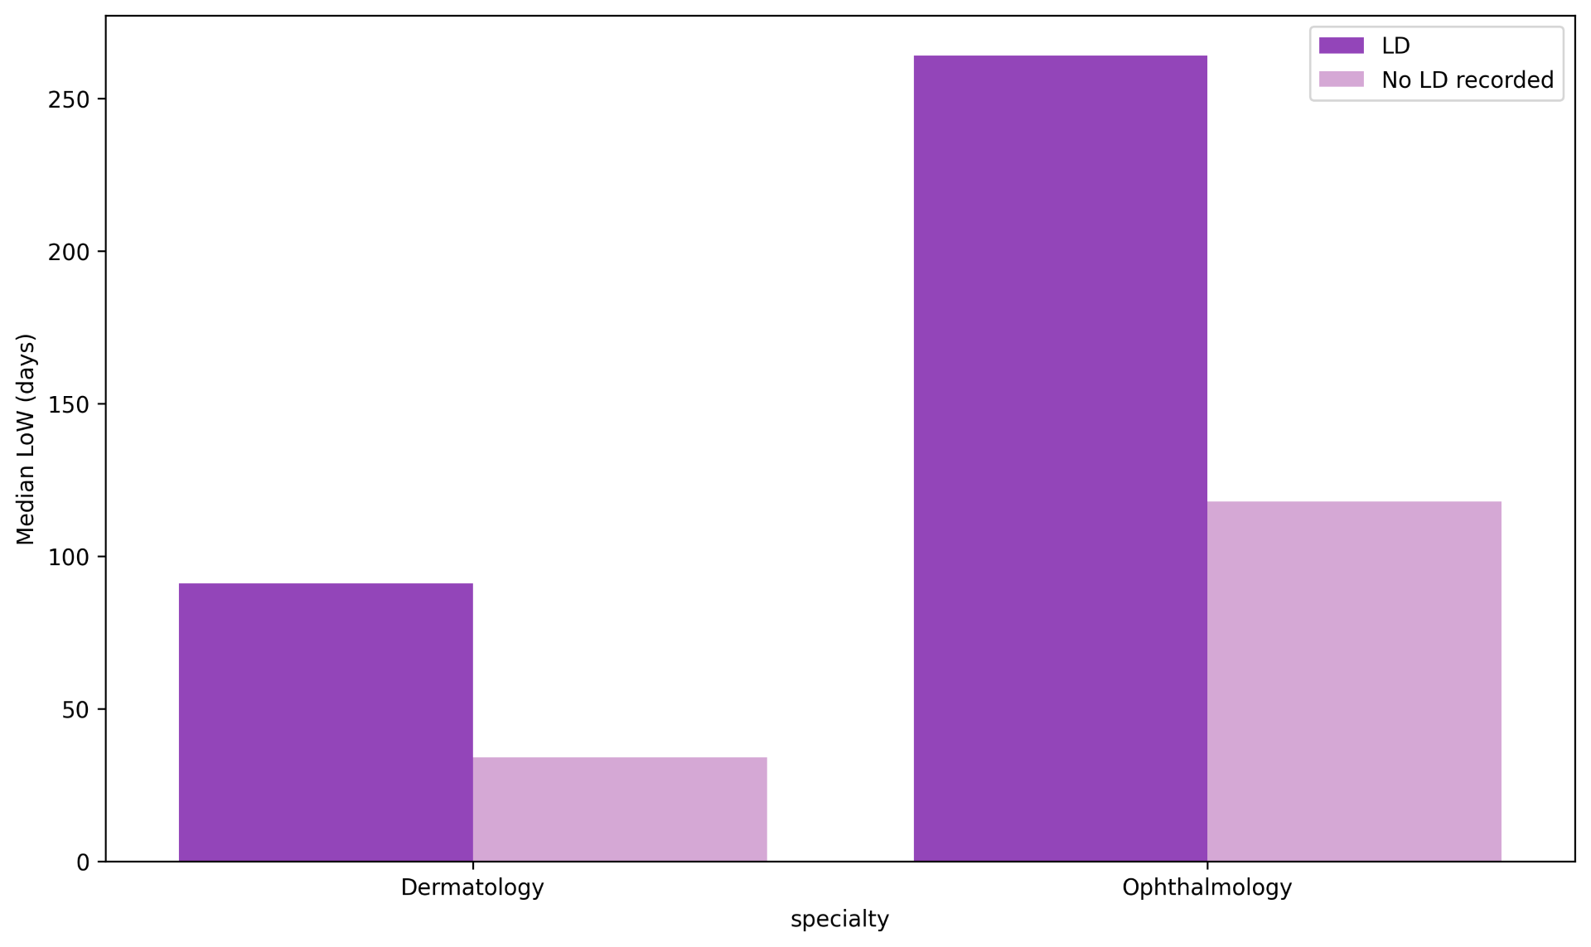
Waiting Time Differential

Slide 8
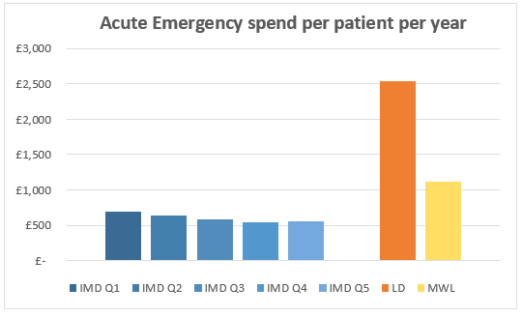
UHP Waiting List patients – Emergency Spend PPPY by cohort
Prioritizing patients with learning disabilities will significantly reduce total acute emergency spend.

Slide 9
Acute Emergency Spend

Slide 10
Identify the rationale behind differential access to care
Develop and implement operational interventions to reduce delays in waiting list for LD population.
Waiting Well Initiative
Aims

Slide 11
Methods
Identify Rationale for Differential Access
Reducing Delays
Waiting Well Initiative
Implement operational approaches
MDT-led care
Creation of a role to support the LD population
PPIE to inform interventions
PPIE
Scoping Review
Subgroup analysis of Data
Constant Re-evaluation and Improvement

Slide 12
Notes:
PPIE – survey at a carers event at Guildhall, same survey by email to carers around the patch ; and then in person focus group meeting at Bowden Derra – a living centre for PwLD at Launceston . Similar themes coming through in all – That hospital staff sometimes fail to plan, that even when plans are made they fall through, that reasonable adjustments are often not recognised, that comms are patchy at best

Slide 13
Scoping Review
Scant Literature available
Fragmented care
PPIE
Coordination
Communication
Education/ Awareness
Operational Performance
So Far

Slide 14
Governance: Improve Access Policy
Changing Capacity and Processes
Anecdotal Learning
Changes

Slide 15
Anecdotal Learning
PPIE
Capacity
Patient Journey
Attempt with increasing GA MRI list but not enough patients if you slot them in
Transport, equipment, best interest meeting, legal frameworks
Understanding that they are on the waiting list
Lack of understanding by staff on how to work with patients with LD
Lack of Acknowledgement of repeated traumas/ Hospital Passports
Multiple appointments together
Reasonable Adjustments

Slide 16
Education/ Awareness of Health Care professionals & admin staff
Workstreams
So Far

Slide 17
Name
Patient Details
Notes:
Investigating alerts - SALUS , iPMS , SeeEHR – a central health platform for all in pts , & NerveCentre – the ED electronic platform
All have capability to have this alert – issues are how do you make it stand out from all the alert flags for other conditions ( eg infection control, frailty, falls risk, social and safeguarding , specific med conditions like diabetes ) , AND what should HCW Admin DO when they see it
Peter Hannon – Hospital Passport App – HCW ( doctors especially ) are fickle – if there are too many steps to do something then they won`t – ideal is to click on icon and get through to RA – without password barriers . Doing some scoping work on that locally , but there are plenty barriers ( not least that our trust IMT dept has their hands full migrating to a new Electronic Patient Record, so don’t have an appetite to work on this Hospital Passport right now, which they see as a hobby “project” )

Slide 18
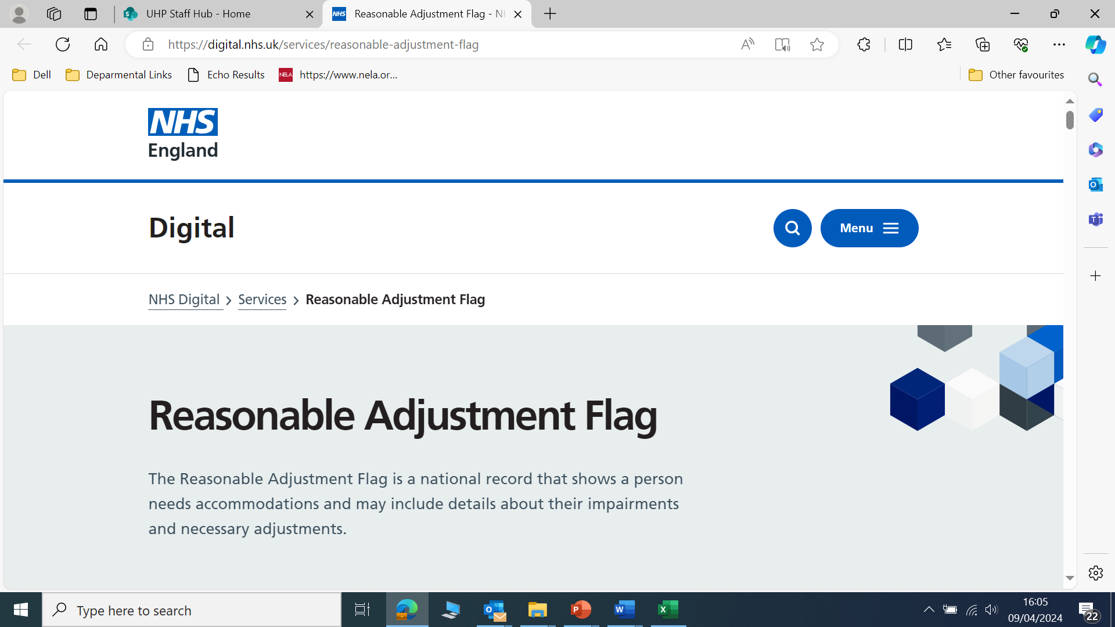
Notes:
But – there is some hope on the horizon – we`ve realised – our role is NOT to sort out the IT for the whole hospital – but to have a comms campaign to raise awareness about reasonable adjustments – this slide shows a national NHS England role out project – the “reasonable adjustments digital flag ( RADF) which is intended to be on the NHS spine ie stored and accessible under their NHS number for every patient . The problems are twofold : 1. a comms campaign so that health & socialcare workers know it is there and can access it to look up individualised reasonable adjustments and 2. that somebody needs to fill the data in there – there is still information governance to be unpicked about who can write stuff in there for individuals, AND THEN somebody needs to have the time to write the data in ( and as yet – not time or funding has been set aside for that activity ( and probably never will be O

Slide 19
How is this relevant to Perioperative Care
Communication
Logistics and Coordination
Moving Forward
Booking and communicating appointments (easy read)
Transport and reasonable adjustment
Whether legal team are needed to get involved
Ensure LD team and wider MDT are aware of patient's needs
Can all appointments happen together – Best interest, Pre-op investigations etc
Alert system and NHS Spine
Checklist

Slide 20
Thank you
Reducing Inequitable Delays for Procedures for Patients with Learning Disabilities
Adrienne.lee@nhs.net

