Slide 1

‘Courageous Conversations’
Primary Care Training Workshop

Slide 2

Having challenging conversations with people about cancer and at the end of life

Slide 3
Workshop aims
To support Primary Care Professionals (PCPs) to have conversations with people about cancer from diagnosis to discussions at the end of life
To recognise the role health professionals play in helping people discuss cancer, empowering them to ask questions and helping them plan life choices
To highlight that the skills needed to have these conversations well, as with all skills, need good quality and regular training

Slide 4
Implications for actions
Good communication is vital to make it easier for people to talk about a cancer diagnosis and their specific worries about the impact on their life and those around them including prognosis
People are more likely to feel able to talk to health professionals they trust or know well
As PCPs we need to have the skills and confidence to have these conversations, sometimes in difficult situations and without all the information we would ideally like to have

Slide 5
Causes of death – England
Causes of death – England
Cancer 27%
Circulatory system 24%
    Stroke 6%
Respiratory system 14%
Nervous system 7%
Other 28%
Data on Mortality statistics - underlying cause for the year 2018 obtained from Nomis, the University of Durham, on behalf of the Office for National Statistics.
“Stroke” is part of ICD10 I00-99 IX. Diseases of the circulatory system and it includes other I60-69 Cerebrovascular diseases.

Slide 6
Causes of death – Wales
Causes of death – Wales
Cancer 27%
Circulatory system 25%
    Stroke 6%
Respiratory system 16%
Nervous system 5%
Other 28%
Data on Mortality statistics - underlying cause for the year 2018 obtained from Nomis, the University of Durham, on behalf of the Office for National Statistics.
“Stroke” is part of ICD10 I00-99 IX. Diseases of the circulatory system and it includes other I60-69 Cerebrovascular diseases.

Slide 7
Causes of death – Scotland
Causes of death – Scotland
Cancer 28%
Circulatory system 25%
    Stroke 6%
Respiratory system 12%
Nervous system 7%
Other 28%
Data on Deaths - Causes for the year 2018 from the Vital Events Reference Tables 2018 obtained from National Records of Scotland.
“Stroke” is part of ICD10 I00-99 IX. Diseases of the circulatory system and it includes other I60-69 Cerebrovascular diseases.

Slide 8
Causes of death – Northern Ireland
Causes of death – Northern Ireland
Cancer 28%
Circulatory system 24%
    Stroke 6%
Respiratory system 13%
Nervous system 7%
Other 29%
Data from Cause of Death 2017 Tables from the Registrar General Annual Report 2017 Cause of Death obtained from the Northern Ireland Statistics and Research Agency.
“Stroke” is part of ICD10 I00-99 IX. Diseases of the circulatory system and it includes other I60-69 Cerebrovascular diseases.

Slide 9
End of life trajectories

Slide 10
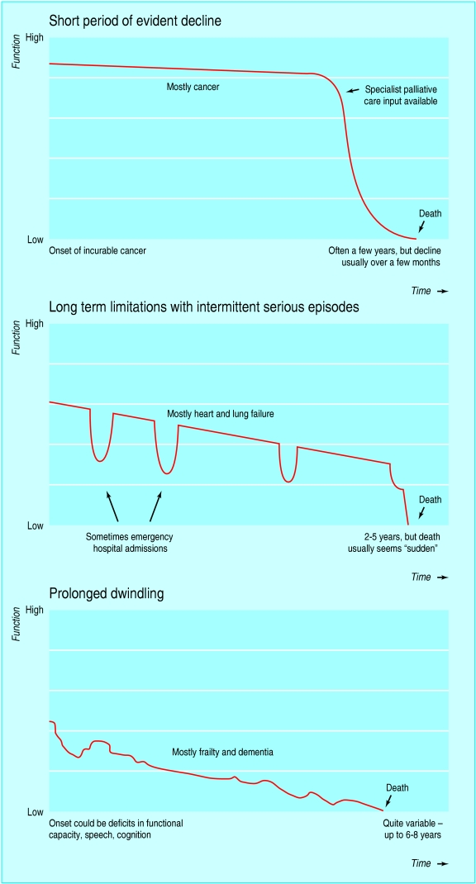
Illness trajectories and palliative care
Scott A Murry, Marilyn Kendall, Kirsty Boyd and Aziz Sheikh
BMJ 2005;330;1007-1011
Doi:10.1136/bmj.330.7498.1007

Slide 11
Illness trajectories and palliative care
Scott A Murry, Marilyn Kendall, Kirsty Boyd and Aziz Sheikh
BMJ 2005;330;1007-1011
Doi:10.1136/bmj.330.7498.1007

Slide 13
The changing outcomes for People Living With Cancer (PLWC)
The experience with cancer is unique to the individual
The trajectory for people after a cancer diagnosis can be very different, even with the same tumour type
This can leave PLWC with a lot of uncertainty
Likewise, as PCPs, we can often have much uncertainty as to what someone should expect whether it be about treatment or prognosis
As the cancer landscape changes, as PCPs, we may find ourselves needing to have different conversations with people about cancer

Slide 14
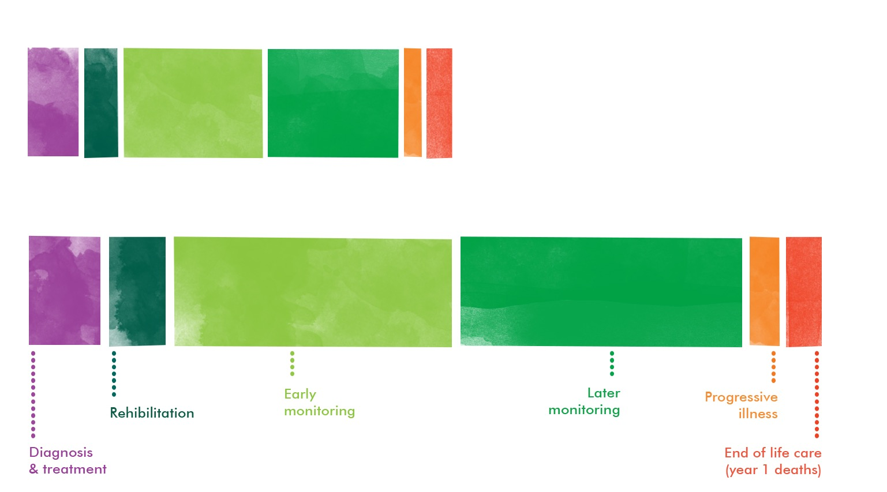
Cancer prevalence is changing – challenging conversations may differ along the pathway
Total Prevalence – now
Total Prevalence – 2030
Maddams J, Utley M, Moller H. Projections of cancer prevalence in the United Kingdom, 2010-2040. Br J Cancer. 2012. 107: 1195-1202.

Slide 15

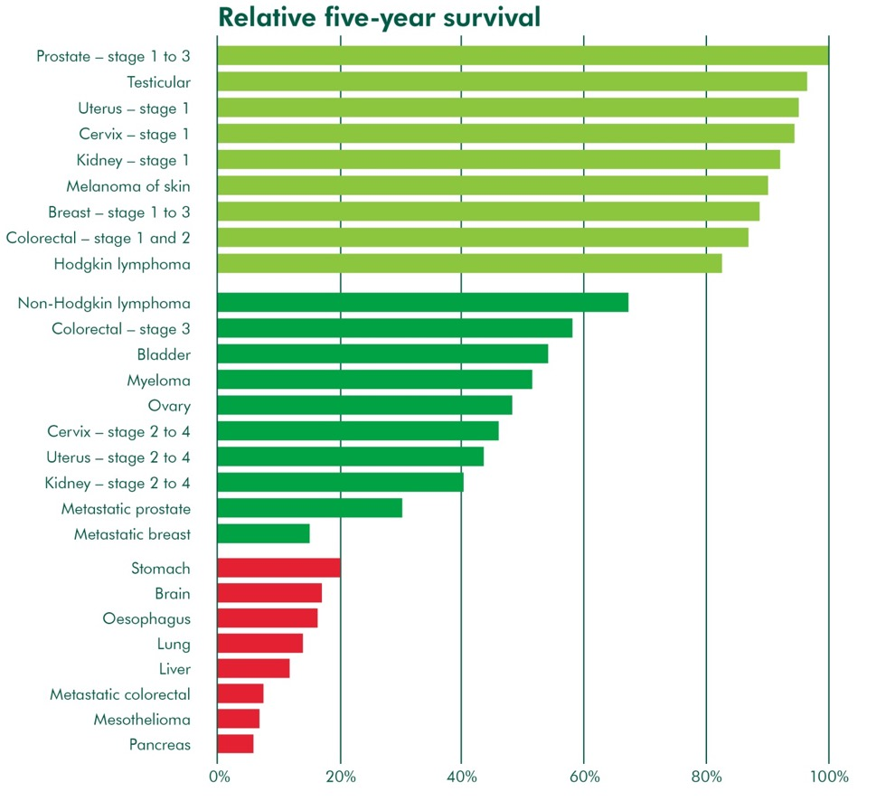


Three broad cancer groups
McConnell, H. White, R. And Maher, J. 2015. Explaining the different complexity, intensity and longevity of broad clinical needs.
Notes:
The story is complex, but there are ways to simplify: three groups.
Huge variation in outcome for different types of cancer.
This is a population framework which looks at the population by 5 year survival. Survival for different cancers is vastly different.
At a very high level we can sort the population into roughly three groups based on average five year survival.
Those in group 1 will often live for more than five years following diagnosis whereas those in group 3 are much more likely to die in the first 5 years (or even the first year) after diagnosis.
Group 1, for example, includes people who may have long term consequences of their treatment – it’s really important to be thinking about long term consequences when making treatment decisions.
Group 2 are more likely to have a complex journey with several decision points. Many in this group will have an uncertain prognosis and face some really tough decisions – “Do I continue with curative treatment or move on to palliative care”
In Group 3 Early Diagnosis is even more important, as is palliative care and the coordination of palliative care with other treatments
Even this more detailed picture masks nuances. Our Routes from Diagnosis work, which we published in 2014, showed that even among women whose breast cancer is diagnosed early, the majority do not ‘do well’ - of those who are diagnosed with non-metastatic disease and survive seven years or more, 69% will be in poor health. This finding is backed up by some of the health economics work we’ve funded at City University and has recently been published in the BCJ. This work also shows people continue to access healthcare at a higher rate than the general population years after they have completed active treatment. t the range of complexity, intensity and longevity of broad clinical needs.

Slide 16
Challenging conversations about cancer – can happen across the whole pathway
Cancer fear – people may avoid tests and appointments because they are worried about what will be found
Urgent referrals – communicating well regarding a referral can help ensure that people attend appointments
Communicating a diagnosis – mainly something done in secondary care but with new pathways, more direct access tests and advanced IT, we may increasingly find ourselves as the first person giving bad news about cancer
Treatment decisions – patients may want help from their PCP in making these decisions

Slide 17
Times of need
Living with cancer and managing psychological effects – anxiety, depression and fear of recurrence
Treatable not curable cancer – patients facing multiple courses of treatment and an unclear prognosis
Decisions about palliative treatment – helping PLWC make decisions about stopping or declining treatment
End of life – discussing changes in prognosis and likelihood that in last phase of life
Advance Care Planning – either early or late in the disease trajectory

Slide 18
What are the challenges?
Lack of confidence in having difficult conversations
Practical issues – time
Lack of training – not having practised ways/phrases to enable the discussions
Lack of information/knowledge and not being confident in having these conversations with uncertainty
Worry about how someone might react

Slide 19
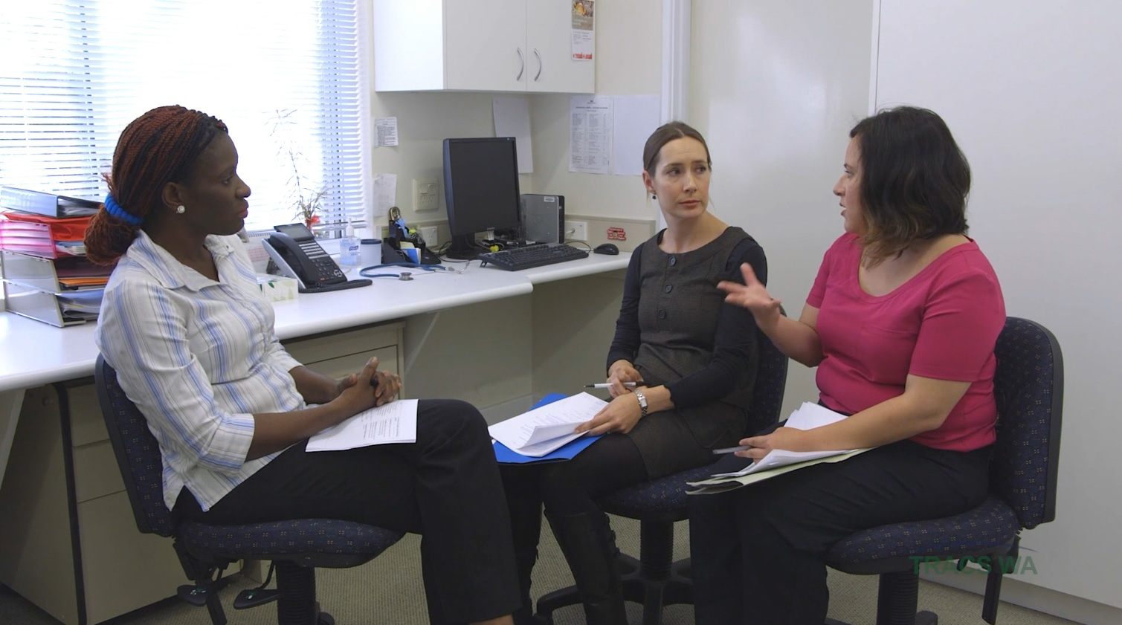
Who needs to be trained to have conversations about cancer and end of life care?
PCPs – GPs, Nurses, AHPs
Community/District Nursing staff
Heart failure/COPD/LTC nurses
Community specialist palliative care team
Hospital doctors
  Palliative care
  Other specialties

Slide 20
Times of need – what might trigger a conversation
Deteriorating despite optimally tolerated therapy
Increasing functional dependence
Progressive fatigue
Recurring hospitalisations
Emotional distress
Carer exhaustion
Patient request
O’Leary N et al. Eur J Heart Fail 2009, 11: 406-11

Slide 21
Why is it important for patients?
Opening the conversation allows patients to:
Explore options and discuss fears
Identify wishes and preferences
Decide on or refuse specific treatment
Ask someone to speak on their behalf
Appoint someone to make decisions for them using a Lasting Power of Attorney if appropriate
Let people know their wishes giving them peace of mind

Slide 22
Some views
“It’s not easy to talk about end of life issues but it’s important to do. Now that we’ve put our affairs in order and talked about what we want, we can ‘put that in a box’ as it were, and get on with living one day at a time, cherishing each day together, as I know its going to end one day.”
“It’s normal – it’s going to happen to us all as some point!”
“If you talk about dying, you can say everything you want and need to. There are no regrets”
“If you talk about it, you can make the most of life.”

Slide 23
Why don’t we talk about dying and death?

Slide 24
Why don’t we talk about dying and death?
Individuals, family and friends, professionals and society are reluctant to discuss dying and death. Why?
What are the advantages of avoidance?
What are the disadvantages?

Slide 25
Communication principles and strategies

Slide 26
Important elements for a successful conversation
The setting or environment is important – not always flexible but can make the most of what we have
Having a practised structure can be helpful
Having the confidence and skills to ask about patients’ concerns and feelings.
You can’t guess what the concerns are – you have to ask
Important not to listen selectively for the concerns we can address - need to feel comfortable approaching issues that we might not immediately have answers/solutions for
We should seek the patient’s own solutions before we start to solve problems
(Connelly et al 2010)

Slide 27
Behaviours and skills that can help a conversation be effective
Non-verbal
  Being attentive
  Eye contact
  Nodding
  Looking concerned
  Leaving space for patient to talk

Slide 28
Behaviours and skills that show we are listening
Verbal behaviours
  Open questions
  Picking up and responding to cues – verbal and non-verbal
  Questions about feelings
  Clarifying
  Summarising and reflecting back to check our understanding
  Empathy
  Educated guesses
  (Fallowfield et al 2014, Robertson 2005

Slide 29
Behaviours that block two-way communication and patient disclosure
Closed questions
Leading questions
Multiple questions
Ignoring cues
Giving information too soon
Giving reassurance too soon
Normalising/minimizing concerns
McGuire & Pitceathly 2002

Slide 30
Time to sit back and watch

Slide 31
A video simulated conversation
Watch the consultation – please concentrate on the communication aspects, try to pay less attention to the clinical issues.
Note positive aspects and also missed opportunities to facilitate good and effective communication. (Make some notes)
Be ready to discuss things that could have been done differently or better. Think of specific actions, words or phrases that might be used.

Slide 32
Video consultation 2
The consultation will now be re-run
Are there improvements?
Again note specific behaviours and language that are effective.
How might the consultation be further improved?

Slide 33
An improved consultation
Now we will re-run of the same consultation with a fellow facilitator
Are there improvements?
Again note specific behaviours and language that are effective.
How might the consultation be further improved?

Slide 34
Skills practice
Trying some strategies and phrases in a safe environment

Slide 35
Consultation skills practice (1)
There will be feedback on the consultation
Learner is the healthcare ‘professional’
Observer manages the process
Consultation
Observer may stop part of the consultation at any time - don’t let people get too stuck

Slide 36
Skills practice (2)
‘Professional’ comments on strengths first
‘Patient’ and observer comment on strengths
‘Professional’ comments on challenges/difficulties
‘Patient’ and observer comment on difficulties but only with suggestions of alternative strategies/form of words etc
‘Professional’ has chance, if desired, to re-run consultation with alternative strategies and repeat feedback cycle

Slide 37
Observer role
Manage the process and the time
Guardian of the ground rules – protect the learner from destructive criticism
Stick to the Oxford rule of positives first, be willing to contribute if others can’t see anything good!
Ensure no criticism without suggestion of alternative – maybe ask critic to demonstrate

Slide 38
You may wish to add a slide showing groups
for the scenario role play

